Slide 1
DATA STORYTELLING & STATISTICAL VALIDATION
Presented By
Dhudukala Thapaswini

Slide 2
OBJECTIVES
To transform raw data into meaningful business insights through clear storytelling.
To identify patterns, trends, and customer behavior using data analysis techniques.
To present analytical findings in a simple, visual, and understandable manner.
To support decision-making with data-driven conclusions and recommendations.
To validate key findings using statistical methods for better accuracy and reliability.
To compare business outcomes and measure the impact of different factors statistically.
To improve communication between technical analysis and business understanding.
To create an engaging presentation that effectively conveys insights and actions.

Slide 3
DATASET OVERVIEW
The dataset, “E-commerce Customer Behavior”, contains customer transaction and shopping behavior information collected from an e-commerce platform. It is designed to analyze how customers interact with products, make purchases, and respond to factors such as discounts, payment methods, and shopping frequency.
The dataset includes details related to:
Customer demographics and shopping preferences
Product categories and purchase patterns
Total spending and transaction behavior
Discount usage and payment methods
Customer satisfaction and engagement trends

Slide 4
This dataset is useful for:
Exploratory Data Analysis (EDA)
Customer Segmentation Analysis
Sales and Revenue Insights
Statistical Validation and Hypothesis Testing
Data Storytelling and Business Decision-Making
By analyzing this dataset, businesses can better understand customer behavior, improve marketing strategies, enhance customer experience, and make data-driven decisions to increase overall business performance.

Slide 5
DATA CLEANING
Data cleaning is an important step performed to improve the quality, consistency, and accuracy of the dataset before analysis. The following cleaning processes were carried out on the E-commerce Customer Behavior dataset:
Checked for missing or null values in all columns.
Removed duplicate records to avoid repeated data analysis.
Corrected inconsistent data formats and standardized column values.
Verified data types for numerical and categorical attributes.
Handled incorrect or irrelevant entries in the dataset.
Ensured consistency in customer, product, and transaction information.
Prepared the dataset for Exploratory Data Analysis (EDA) and statistical validation.
After cleaning, the dataset became more reliable and suitable for generating accurate insights, visualizations, and business recommendations.

Slide 6
DASHBOARD OVERVIEW
The dashboard provides a comprehensive visual analysis of the E-commerce Customer Behavior dataset by presenting key business insights through interactive charts, graphs, and KPIs. It helps in understanding customer purchasing patterns, spending behavior, and overall business performance in a simple and visually appealing manner.
Key Highlights of the Dashboard:
Analysis of customer spending and purchase trends
Comparison of customers based on discount usage and payment methods
Visualization of product category performance and sales distribution
Identification of customer segments and shopping frequency patterns
Statistical insights to validate important business findings
Interactive visuals for better data exploration and decision-making

Slide 7
Purpose of the Dashboard:
To convert complex data into meaningful visual insights
To support data-driven business strategies and decisions
To identify opportunities for improving customer engagement and sales
To communicate findings effectively through data storytelling techniques
The dashboard enables stakeholders to quickly interpret data, monitor business performance, and make informed decisions based on analytical insights.

Slide 8
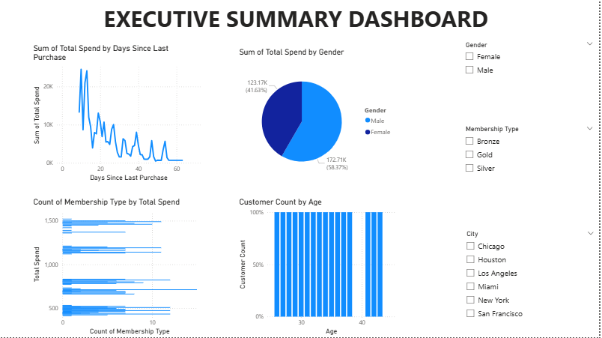

Slide 9
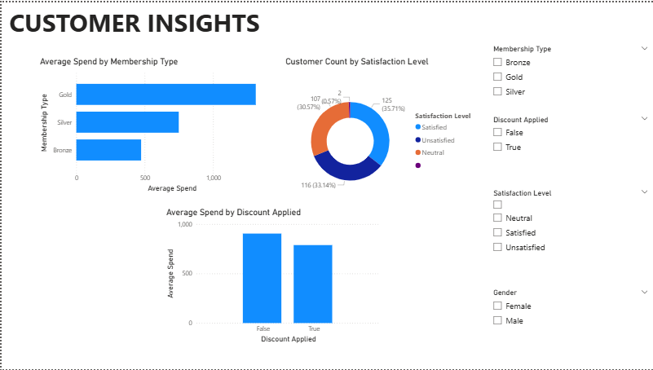

Slide 10
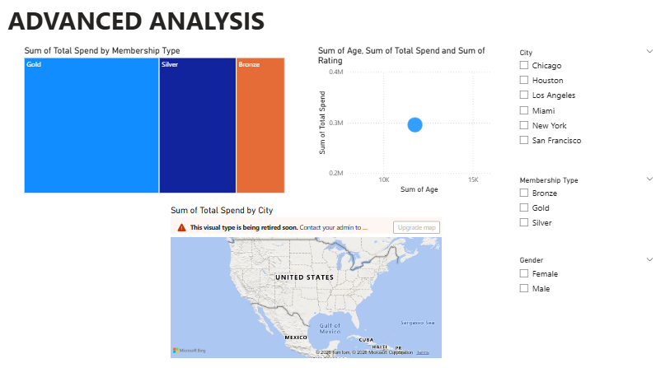

Slide 11
CUSTOMER INSIGHTS
Customers who received discounts showed higher overall spending compared to customers without discounts.
Certain product categories generated more sales and attracted higher customer engagement.
Most customers preferred digital payment methods due to convenience and faster transactions.
Frequent shoppers contributed significantly to the total revenue of the business.
Customer purchasing behavior varied based on shopping frequency and spending patterns.
Statistical analysis indicated meaningful differences in spending between different customer groups.
The dashboard revealed valuable trends that can help improve marketing and customer retention strategies.
Understanding customer behavior enables businesses to provide personalized offers and improve customer satisfaction.

Slide 12
SALES INSIGHTS
Product categories with higher customer demand contributed the most to total sales revenue.
Customers who used discounts generated increased purchase volumes and higher sales performance.
Frequent purchases from loyal customers played a major role in overall business growth.
Digital payment methods were associated with a larger number of successful transactions.
Seasonal and purchasing trends helped identify peak sales periods and customer preferences.
Higher customer spending patterns indicated opportunities for targeted marketing strategies.
Statistical validation confirmed significant differences in sales behavior among customer groups.
The analysis highlighted areas where businesses can improve sales performance and customer retention.

Slide 13
HYPOTHESIS TESTING
Hypothesis Testing
Hypothesis testing was performed to statistically validate whether discounts have a significant impact on customer spending behavior.
Null Hypothesis (H₀):
There is no significant difference in total spending between customers who received discounts and those who did not receive discounts.
Alternative Hypothesis (H₁):
There is a significant difference in total spending between customers who received discounts and those who did not receive discounts.
Statistical Method Used:
Independent Sample T-Test
Result:
The calculated p-value was compared with the significance level (α = 0.05).
Since the p-value was less than 0.05, the null hypothesis was rejected.

Slide 14
BUSINESS RECOMMENDATIONS
Offer attractive discounts and promotional campaigns to encourage higher customer spending.
Focus more on high-performing product categories to maximize sales and profitability.
Implement personalized marketing strategies based on customer purchasing behavior and preferences.
Improve customer retention programs for frequent and loyal shoppers.
Enhance digital payment options to provide faster and more convenient transactions.
Use customer segmentation techniques to target specific customer groups effectively.
Monitor sales trends and customer feedback regularly to improve business performance.
Apply data-driven decision-making and statistical analysis for future business strategies and planning.

Slide 15
CONCLUSION
The Data Storytelling and Statistical Validation project successfully analyzed the E-commerce Customer Behavior dataset to identify meaningful business insights and customer trends. Through data cleaning, visualization, exploratory analysis, and hypothesis testing, the project transformed raw data into actionable information for decision-making.
The analysis revealed that factors such as discounts, shopping frequency, and product preferences significantly influence customer spending behavior. Statistical validation confirmed that discounts have a measurable impact on total customer spending, helping businesses understand the effectiveness of promotional strategies.
The interactive dashboard and storytelling approach made complex data easier to interpret and communicate. Overall, this project demonstrates how data analytics and statistical methods can support businesses in improving customer engagement, increasing sales performance, and making informed, data-driven decisions.

Slide 16
THANK YOU

